Slide 1
Chapter 4 Mathematical Functions, Characters, and Strings

Slide 2
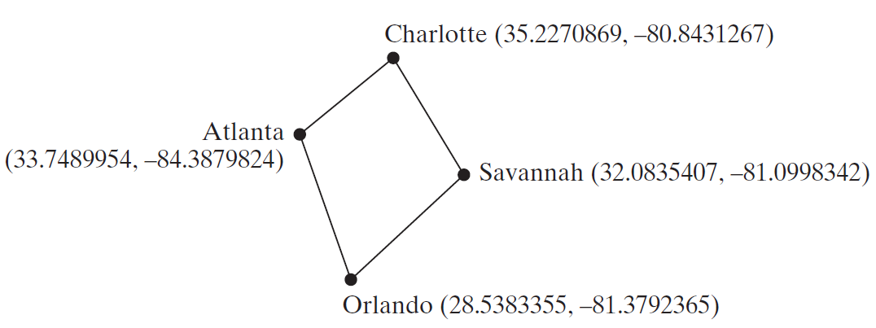
Motivations
Suppose you need to estimate the area enclosed by four cities, given the GPS locations (latitude and longitude) of these cities, as shown in the following diagram. How would you write a program to solve this problem? You will be able to write such a program after completing this chapter.

Slide 3
Objectives
To solve mathematics problems by using the methods in the Math class (§4.2).
To represent characters using the char type (§4.3).
To encode characters using ASCII and Unicode (§4.3.1).
To represent special characters using the escape sequences (§4.4.2).
To cast a numeric value to a character and cast a character to an integer (§4.3.3).
To compare and test characters using the static methods in the Character class (§4.3.4).
To introduce objects and instance methods (§4.4).
To represent strings using the String objects (§4.4).
To return the string length using the length() method (§4.4.1).
To return a character in the string using the charAt(i) method (§4.4.2).
To use the + operator to concatenate strings (§4.4.3).
To read strings from the console (§4.4.4).
To read a character from the console (§4.4.5).
To compare strings using the equals method and the compareTo methods (§4.4.6).
To obtain substrings (§4.4.7).
To find a character or a substring in a string using the indexOf method (§4.4.8).
To program using characters and strings (GuessBirthday) (§4.5.1).
To convert a hexadecimal character to a decimal value (HexDigit2Dec) (§4.5.2).
To revise the lottery program using strings (LotteryUsingStrings) (§4.5.3).
To format output using the System.out.printf method (§4.6).

Slide 4
Mathematical Functions
Java provides many useful methods in the Math class for performing common mathematical functions.

Slide 5
The Math Class
Class constants:
PI
E
Class methods:
Trigonometric Methods
Exponent Methods
Rounding Methods
min, max, abs, and random Methods

Slide 6
Trigonometric Methods
sin(double a)
cos(double a)
tan(double a)
acos(double a)
asin(double a)
atan(double a)
Examples:
Math.sin(0) returns 0.0
Math.sin(Math.PI / 6) returns 0.5
Math.sin(Math.PI / 2) returns 1.0
Math.cos(0) returns 1.0
Math.cos(Math.PI / 6) returns 0.866
Math.cos(Math.PI / 2) returns 0
Radians
toRadians(90)

Slide 7
Exponent Methods
exp(double a)
Returns e raised to the power of a.
log(double a)
Returns the natural logarithm of a.
log10(double a)
Returns the 10-based logarithm of a.
pow(double a, double b)
Returns a raised to the power of b.
sqrt(double a)
Returns the square root of a.
Examples:
Math.exp(1) returns 2.71
Math.log(2.71) returns 1.0
Math.pow(2, 3) returns 8.0
Math.pow(3, 2) returns 9.0
Math.pow(3.5, 2.5) returns 22.91765
Math.sqrt(4) returns 2.0
Math.sqrt(10.5) returns 3.24

Slide 8
Rounding Methods
double ceil(double x)
x rounded up to its nearest integer. This integer is returned as a double value.
double floor(double x)
x is rounded down to its nearest integer. This integer is returned as a double value.
double rint(double x)
x is rounded to its nearest integer. If x is equally close to two integers, the even one is returned as a double.
int round(float x)
Return (int)Math.floor(x+0.5).
long round(double x)
Return (long)Math.floor(x+0.5).

Slide 9
Rounding Methods Examples
Math.ceil(2.1) returns 3.0
Math.ceil(2.0) returns 2.0
Math.ceil(-2.0) returns –2.0
Math.ceil(-2.1) returns -2.0
Math.floor(2.1) returns 2.0
Math.floor(2.0) returns 2.0
Math.floor(-2.0) returns –2.0
Math.floor(-2.1) returns -3.0
Math.rint(2.1) returns 2.0
Math.rint(2.0) returns 2.0
Math.rint(-2.0) returns –2.0
Math.rint(-2.1) returns -2.0
Math.rint(2.5) returns 2.0
Math.rint(-2.5) returns -2.0
Math.round(2.6f) returns 3
Math.round(2.0) returns 2
Math.round(-2.0f) returns -2
Math.round(-2.6) returns -3

Slide 10
min, max, and abs
max(a, b)and min(a, b)
Returns the maximum or minimum of two parameters.
abs(a)
Returns the absolute value of the parameter.
random()
Returns a random double value in the range [0.0, 1.0).
Examples:
Math.max(2, 3) returns 3
Math.max(2.5, 3) returns 3.0
Math.min(2.5, 3.6) returns 2.5
Math.abs(-2) returns 2
Math.abs(-2.1) returns 2.1

Slide 11
The random Method
Generates a random double value greater than or equal to 0.0 and less than 1.0 (0 <= Math.random() < 1.0).
Examples:
In general,

Slide 12
Case Study: Computing Angles of a Triangle
Write a program that prompts the user to enter the x- and y-coordinates of the three corner points in a triangle and then displays the triangle’s angles.
IMPORTANT NOTE: If you cannot run the buttons, see https://liveexample.pearsoncmg.com/slide/javaslidenote.doc.
ComputeAngles
Run

Slide 13
☑ Check Point
Evaluate the following method calls:
(a) Math.sqrt(4) (b) Math.sin(2 * Math.PI) (c) Math.cos(2 * Math.PI)
(d) Math.pow(2, 2) (e) Math.log(Math.E) (f) Math.exp(1)
(g) Math.max(2, Math.min(3, 4)) (h) Math.rint(-2.5) (i) Math.ceil(-2.5)
(j) Math.floor(-2.5) (k) Math.round(-2.5f) (l) Math.round(-2.5)
(m) Math.rint(2.5) (n) Math.ceil(2.5) (o) Math.floor(2.5)
(p) Math.round(Math.abs(-2.5)) (q) Math.round(2.5f) (r) Math.round(2.5)
<--- ANSWER --->
(a) 2.0 (b) 0 (c) 1
(d) 4.0 (e) 1.0 (f) 2.718
(g) 3 (h) -2.0 (i) -2.0
(j) -3.0 (k) -2 (l) -2
(m) 2.0 (n) 3.0 (o) 2.0
(p) 3 (q) 3 (r) 3

Slide 14
☑ Check Point
True or false? The argument for trigonometric methods is an angle in radians.
Write a statement that converts 47 degrees to radians and assigns the result to a variable.
Write a statement that converts π / 7 to an angle in degrees and assigns the result to a variable.
<--- ANSWER --->
True
double radians = Math.toRadians(47);
double degree = Math.toDegrees(Math.PI / 7);

Slide 15
☑ Check Point
Write an expression that obtains a random integer between 34 and 55.
Write an expression that obtains a random integer between 0 and 999.
Write an expression that obtains a random number between 5.5 and 55.5.
<--- ANSWER --->
34 + (int)(Math.random() * (55 - 34))
(int)(Math.random() * 1000)
5.5 + (Math.random() * (55.5 - 5.5))

Slide 16
☑ Check Point
Why does the Math class not need to be imported?
<--- ANSWER --->
The Math class is in the java.lang package. Any class in the java.lang package is automatically imported. So, there is no need to import it explicitly.

Slide 17
☑ Check Point
What is Math.log(Math.exp(5.5))?
What is Math.exp(Math.log(5.5))?
What is Math.asin(Math.sin(Math.PI / 6))?
What is Math.sin(Math.asin(Math.PI / 6))?
<--- ANSWER --->
5.5
5.5
0.5235987755982988
0.5235987755982988

Slide 18
Character Data Type
Four hexadecimal digits.
char letter = 'A'; (ASCII)
char numChar = '4'; (ASCII)
char letter = '\u0041'; (Unicode)
char numChar = '\u0034'; (Unicode)
NOTE: The increment and decrement operators can also be used on char variables to get the next or preceding Unicode character. For example, the following statements display character b.
char ch = 'a';
System.out.println(++ch);

Slide 19
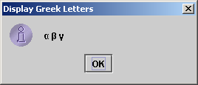
Unicode Format
Java characters use Unicode, a 16-bit encoding scheme established by the Unicode Consortium to support the interchange, processing, and display of written texts in the world’s diverse languages. Unicode takes two bytes, preceded by \u, expressed in four hexadecimal numbers that run from '\u0000' to '\uFFFF'. So, Unicode can represent 65535 + 1 characters.
Unicode \u03b1 \u03b2 \u03b3 for three Greek letters

Slide 20
ASCII Code for Commonly Used Characters

Slide 21
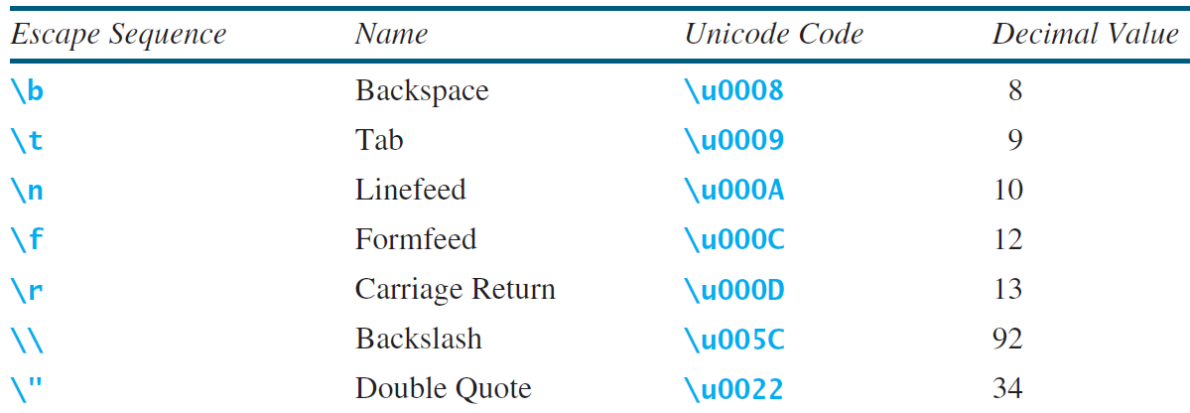
Escape Sequences for Special Characters

Slide 22
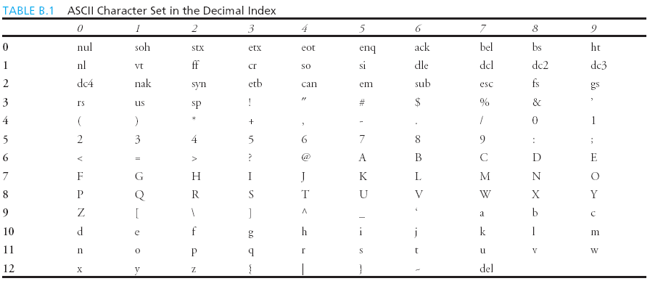
Appendix B: ASCII Character Set
ASCII Character Set is a subset of the Unicode from \u0000 to \u007f

Slide 23
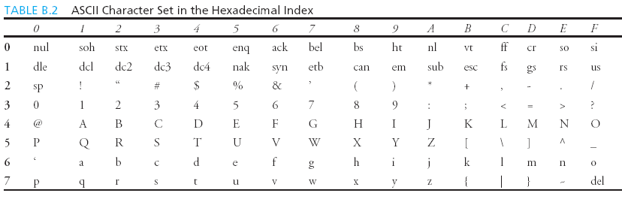
ASCII Character Set, cont.
ASCII Character Set is a subset of the Unicode from \u0000 to \u007f

Slide 24
Casting between char and Numeric Types
int i = 'a'; // Same as int i = (int)'a';
char c = 97; // Same as char c = (char)97;

Slide 25
Comparing and Testing Characters
if (ch >= 'A' && ch <= 'Z')
System.out.println(ch + " is an uppercase letter");
else if (ch >= 'a' && ch <= 'z')
System.out.println(ch + " is a lowercase letter");
else if (ch >= '0' && ch <= '9')
System.out.println(ch + " is a numeric character");

Slide 26
Methods in the Character Class

Slide 27
☑ Check Point
Use print statements to find out the ASCII code for '1', 'A', 'B', 'a', and 'b'.
Use print statements to find out the character for the decimal codes 40, 59, 79, 85, and 90.
Use print statements to find out the character for the hexadecimal code 40, 5A, 71, 72, and 7A.
<--- ANSWER --->
System.out.println((int)'1'); System.out.println((int)'A'); System.out.println((int)'B'); System.out.println((int)'a'); System.out.println((int)'b');
System.out.println((char)40); System.out.println((char)59); System.out.println((char)79); System.out.println((char)85); System.out.println((char)90);
System.out.println((char)0X40); System.out.println((char)0X5A); System.out.println((char)0X71); System.out.println((char)0X72); System.out.println((char)0X7A);

Slide 28
☑ Check Point
Which of the following are correct literals for characters? '1', '\u345dE', '\u3fFa', '\b', '\t'
How do you display the characters \ and " ?
Evaluate the values of the following variables: int i = '1'; int j = '1' + '2' * ('4' - '3') + 'b' / 'a'; int k = 'a'; char c = 90;
<--- ANSWER --->
'\u345dE' is wrong. It must have exactly four hex numbers in the Unicode.
'\\' and '\"'
i is 49, since the ASCII code of '1' is 49. j is 100. k is 97 since the ASCII code of 'a' is 97. c is character 'Z' since (int) 'Z' is 90.

Slide 29
☑ Check Point
Can the following conversions involving casting be allowed? If so, find the converted result.
char c = 'A'; float f = 1000.34f; int i = (int)c; int i = (int)f;
double d = 1000.34; int i = 97; int i = (int)d; char c = (char)i;
<--- ANSWER --->
char c = 'A'; float f = 1000.34f; i = (int)c; // i becomes 65 int i = (int)f; // i becomes 1000
double d = 1000.34; int i = 97; int i = (int)d; // i becomes 1000 char c = (char)i; // c becomes 'a'

Slide 30
☑ Check Point
Show the output of the following program: public class Test { public static void main(String[] args) { char x = 'a'; char y = 'c'; System.out.println(++x); System.out.println(y++); System.out.println(x - y); } }
<--- ANSWER --->
b c -2

Slide 31
☑ Check Point
Write the code that generates a random lowercase letter.
Show the output of the following statements:
System.out.println('a' < 'b');
System.out.println('a' <= 'A');
System.out.println('a' > 'b');
System.out.println('a' >= 'A');
System.out.println('a' == 'a');
System.out.println('a' != 'b');
<--- ANSWER --->
(int)(Math.random() * 26 + 'a')
true
false
false
true
true
true

Slide 32
The String Type
The char type only represents one character. To represent a string of characters, use the data type called String. For example,
String message = "Welcome to Java";
String is actually a predefined class in the Java library just like the System class and Scanner class. The String type is not a primitive type. It is known as a reference type. Any Java class can be used as a reference type for a variable. Reference data types will be thoroughly discussed in Chapter 9, “Objects and Classes.” For the time being, you just need to know how to declare a String variable, how to assign a string to the variable, how to concatenate strings, and to perform simple operations for strings.

Slide 33
Simple Methods for String Objects

Slide 34
Simple Methods for String Objects
Strings are objects in Java. The methods in the preceding table can only be invoked from a specific string instance. For this reason, these methods are called instance methods. A non-instance method is called a static method. A static method can be invoked without using an object. All the methods defined in the Math class are static methods. They are not tied to a specific object instance. The syntax to invoke an instance method is
referenceVariable.methodName(arguments).

Slide 35
Getting String Length
String message = "Welcome to Java";
System.out.println("The length of " + message + " is "
+ message.length());

Slide 36
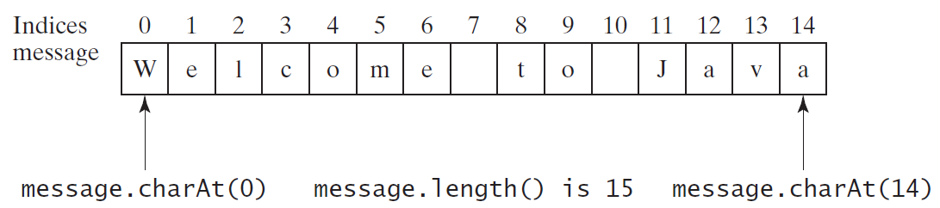
Getting Characters from a String
String message = "Welcome to Java";
System.out.println("The first character in message is "
+ message.charAt(0));

Slide 37
Converting Strings
"Welcome".toLowerCase() returns a new string, welcome.
"Welcome".toUpperCase() returns a new string, WELCOME.
" Welcome ".trim() returns a new string, Welcome.

Slide 38
String Concatenation
String s3 = s1.concat(s2); or String s3 = s1 + s2;
// Three strings are concatenated
String message = "Welcome " + "to " + "Java";
// String Chapter is concatenated with number 2
String s = "Chapter" + 2; // s becomes Chapter2
// String Supplement is concatenated with character B
String s1 = "Supplement" + 'B'; // s1 becomes SupplementB

Slide 39
Reading a String from the Console
Scanner input = new Scanner(System.in);
System.out.print("Enter three words separated by spaces: ");
String s1 = input.next();
String s2 = input.next();
String s3 = input.next();
System.out.println("s1 is " + s1);
System.out.println("s2 is " + s2);
System.out.println("s3 is " + s3);

Slide 40
Reading a Character from the Console
Scanner input = new Scanner(System.in);
System.out.print("Enter a character: ");
String s = input.nextLine();
char ch = s.charAt(0);
System.out.println("The character entered is " + ch);

Slide 41
Comparing Strings
OrderTwoCities
Run

Slide 42
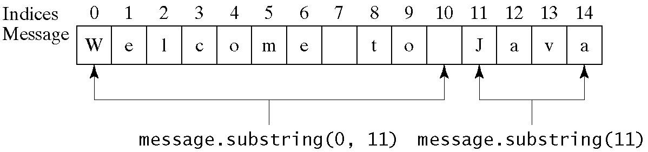
Obtaining Substrings

Slide 43
Finding a Character or a Substring in a String

Slide 44
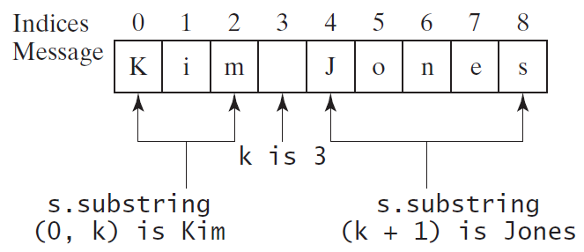
Finding a Character or a Substring in a String
int k = s.indexOf(' ');
String firstName = s.substring(0, k);
String lastName = s.substring(k + 1);

Slide 45
Conversion between Strings and Numbers
int intValue = Integer.parseInt(intString);
double doubleValue = Double.parseDouble(doubleString);
String s = number + "";

Slide 46
☑ Check Point
Suppose that s1, s2, and s3 are three strings, given as follows: String s1 = "Welcome to Java"; String s2 = "Programming is fun"; String s3 = "Welcome to Java"; What are the results of the following expressions?
a. s1 == s2 b. s2 == s3 c. s1.equals(s2)
d. s1.equals(s3) e. s1.compareTo(s2) f. s2.compareTo(s3)
g. s2.compareTo(s2) h. s1.charAt(0) i. s1.indexOf('j')
j. s1.indexOf("to") k. s1.lastIndexOf('a') l. s1.lastIndexOf("o", 15)
m. s1.length() n. s1.substring(5) o. s1.substring(5, 11)
p. s1.startsWith("Wel") q. s1.endsWith("Java") r. s1.toLowerCase()
s. s1.toUpperCase() t. s1.concat(s2) u. s1.contains(s2)
v. "\t Wel \t".trim()
<--- ANSWER --->
a. false b. false c. false
d. true e. a positive number f. a negative number
g. 0 h. W i. -1
j. 8 k. 14 l. 9
m. 15 n. me to Java o. me to
p. true q. true r. welcome to java
s. WELCOME TO JAVA t. Welcome to JavaProgramming is fun u. false
v. Wel

Slide 47
☑ Check Point
Suppose that s1 and s2 are two strings. Which of the following statements or expressions are incorrect?
String s = "Welcome to Java"; String s3 = s1 + s2;
String s3 = s1 - s2; s1 == s2;
s1 >= s2; s1.compareTo(s2);
int i = s1.length(); char c = s1(0);
char c = s1.charAt(s1.length());
<--- ANSWER --->
Correct Correct
Incorrect Correct
Incorrect Correct
Correct Incorrect
Incorrect: it's out of bounds, even if the preceding problem is fixed.

Slide 48
☑ Check Point
Show the output of the following statements (write a program to verify your results):
System.out.println("1" + 1);
System.out.println('1' + 1);
System.out.println("1" + 1 + 1);
System.out.println("1" + (1 + 1));
System.out.println('1' + 1 + 1);
<--- ANSWER --->
11
50 (since the Unicode for 1 is 49)
111
12
51

Slide 49
☑ Check Point
Evaluate the following expressions (write a program to verify your results):
1 + "Welcome " + 1 + 1
1 + "Welcome " + (1 + 1)
1 + "Welcome " + ('\u0001' + 1)
1 + "Welcome " + 'a' + 1
<--- ANSWER --->
1Welcome 11
1Welcome 2
1Welcome 2
1Welcome a1

Slide 50
☑ Check Point
Let s1 be " Welcome " and s2 be " welcome ". Write the code for the following statements:
(a) Check whether s1 is equal to s2 and assign the result to a Boolean variable isEqual.
(b) Check whether s1 is equal to s2, ignoring case, and assign the result to a Boolean variable isEqual.
(c) Compare s1 with s2 and assign the result to an int variable x.
(d) Compare s1 with s2, ignoring case, and assign the result to an int variable x.
(e) Check whether s1 has the prefix AAA and assign the result to a Boolean variable b.
(f) Check whether s1 has the suffix AAA and assign the result to a Boolean variable b.
(g) Assign the length of s1 to an int variable x.
(h) Assign the first character of s1 to a char variable x.
<--- ANSWER --->
(a) boolean isEqual = s1.equals(s2);
(b) boolean isEqual = s1.equalsIgnoreCase(s2);
(c) int x = s1.compareTo(s2);
(d) int x = s1.compareToIgnoreCase(s2);
(e) boolean b = s1.startsWith("AAA");
(f) boolean b = s1.endsWith("AAA");
(g) int x = s1.length();
(h) char x = s1.charAt(0);

Slide 51
☑ Check Point
Let s1 be " Welcome " and s2 be " welcome ". Write the code for the following statements:
(i) Create a new string s3 that combines s1 with s2.
(j) Create a substring of s1 starting from index 1.
(k) Create a substring of s1 from index 1 to index 4.
(l) Create a new string s3 that converts s1 to lowercase.
(m) Create a new string s3 that converts s1 to uppercase.
(n) Create a new string s3 that trims whitespaces on both ends of s1.
(o) Assign the index of the first occurrence of the character e in s1 to an int variable x.
(p) Assign the index of the last occurrence of the string abc in s1 to an int variable x.
<--- ANSWER --->
(i) String s3 = s1 + s2;
(j) String s3 = s1.substring(1);
(k) String s3 = s1.substring(1, 5);
(l) String s3 = s1.toLowerCase();
(m) String s3 = s1.toUpperCase();
(n) String s3 = s1.trim();
(o) int x = s1.indexOf('e');
(p) int x = s1.lastIndexOf("abc");

Slide 52
☑ Check Point
Write one statement to return the number of digits in an integer i.
Write one statement to return the number of digits in a double value d.
What is wrong in the following code? import java.util.Scanner; public class Test { public static void main(String[] args) { Scanner input = new Scanner(System.in); System.out.print("Enter an integer: "); int value = input.nextInt(); System.out.println("The value is " + value); System.out.print("Enter a line: "); String line = input.nextLine(); System.out.println("The line is " + line); } }
<--- ANSWER --->
(i + "").length()
(d + "").length()
input.nextLine() is used after input.nextInt(). Don't use a line-based input after a token-based input.

Slide 53
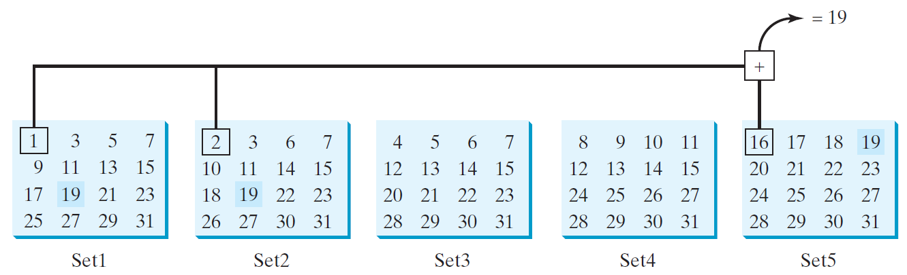
Problem: Guessing Birthday
The program can guess your birth date. Run to see how it works.
GuessBirthday
Run

Slide 54
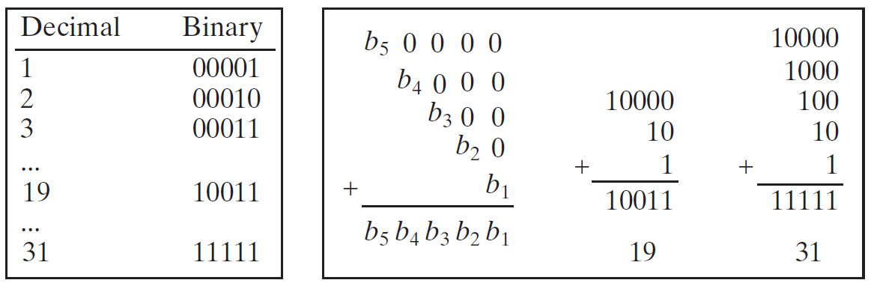
Mathematics Basis for the Game
19 is 10011 in binary. 7 is 111 in binary. 23 is 11101 in binary

Slide 55
Case Study: Converting a Hexadecimal Digit to a Decimal Value
Write a program that converts a hexadecimal digit into a decimal value.
HexDigit2Dec
Run

Slide 56
Case Study: Revising the Lottery Program Using Strings
A problem can be solved using many different approaches. This section rewrites the lottery program in Listing 3.7 using strings. Using strings simplifies this program.
LotteryUsingStrings
Run

Slide 57
☑ Check Point
1 import java.util.Scanner;
2
3 public class GuessBirthday {
4 public static void main(String[] args) {
5 String set1 =
6 " 1 3 5 7\n" +
7 " 9 11 13 15\n" +
8 "17 19 21 23\n" +
9 "25 27 29 31";
10
11 String set2 =
12 " 2 3 6 7\n" +
13 "10 11 14 15\n" +
14 "18 19 22 23\n" +
15 "26 27 30 31";
16
17 String set3 =
18 " 4 5 6 7\n" +
19 "12 13 14 15\n" +
20 "20 21 22 23\n" +
21 "28 29 30 31";
22
23 String set4 =
24 " 8 9 10 11\n" +
25 "12 13 14 15\n" +
26 "24 25 26 27\n" +
27 "28 29 30 31";
28
29 String set5 =
30 "16 17 18 19\n" +
31 "20 21 22 23\n" +
32 "24 25 26 27\n" +
33 "28 29 30 31";
34
35 int day = 0;
36
37 // Create a Scanner
38 Scanner input = new Scanner(System.in);
39
72
73 if (answer == 1)
74 day += 8;
75
76 // Prompt the user to answer questions
77 System.out.print("\nIs your birthday in Set5?\n");
78 System.out.print(set5);
79 System.out.print("\nEnter 0 for No and 1 for Yes: ");
80 answer = input.nextInt();
81
82 if (answer == 1)
83 day += 16;
84
85 System.out.println("\nYour birthday is " + day + "!");
86 }
87 }
40 // Prompt the user to answer questions
41 System.out.print("Is your birthday in Set1?\n");
42 System.out.print(set1);
43 System.out.print("\nEnter 0 for No and 1 for Yes: ");
44 int answer = input.nextInt();
45
46 if (answer == 1)
47 day += 1;
48
49 // Prompt the user to answer questions
50 System.out.print("\nIs your birthday in Set2?\n");
51 System.out.print(set2);
52 System.out.print("\nEnter 0 for No and 1 for Yes: ");
53 answer = input.nextInt();
54
55 if (answer == 1)
56 day += 2;
57
58 // Prompt the user to answer questions
59 System.out.print("Is your birthday in Set3?\n");
60 System.out.print(set3);
61 System.out.print("\nEnter 0 for No and 1 for Yes: ");
62 answer = input.nextInt();
63
64 if (answer == 1)
65 day += 4;
66
67 // Prompt the user to answer questions
68 System.out.print("\nIs your birthday in Set4?\n");
69 System.out.print(set4);
70 System.out.print("\nEnter 0 for No and 1 for Yes: ");
71 answer = input.nextInt();
If you run GuessBirthday.java with input 1 for Set1, Set3, and Set4 and 0 for Set2 and Set5, what will be the birthday?
<--- ANSWER --->
13

Slide 58
☑ Check Point
1 import java.util.Scanner;
2
3 public class HexDigit2Dec {
4 public static void main(String[] args) {
5 Scanner input = new Scanner(System.in);
6 System.out.print("Enter a hex digit: ");
7 String hexString = input.nextLine();
8
9 // Check if the hex string has exactly one character
10 if (hexString.length() != 1) {
11 System.out.println("You must enter exactly one character");
12 System.exit(1);
13 }
14
15 // Display decimal value for the hex digit
16 char ch = hexString.charAt(0);
17 if (ch <= 'F' && ch >= 'A') {
18 int value = ch - 'A' + 10;
19 System.out.println("The decimal value for hex digit "
20 + ch + " is " + value);
21 }
22 else if (Character.isDigit(ch)) {
23 System.out.println("The decimal value for hex digit "
24 + ch + " is " + ch);
25 }
26 else {
27 System.out.println(ch + " is an invalid input");
28 }
29 }
30 }
If you enter a lowercase letter such as b, the program displays B is 11. Revise the code so to display b is 11.
<--- ANSWER --->
Change ch in lines 20, 24, 27 to hexString.charAt(0).

Slide 59
☑ Check Point
1 import java.util.Scanner;
2
3 public class LotteryUsingStrings {
4 public static void main(String[] args) {
5 // Generate a lottery as a two-digit string
6 String lottery = "" + (int)(Math.random() * 10)
7 + (int)(Math.random() * 10);
8
9 // Prompt the user to enter a guess
10 Scanner input = new Scanner(System.in);
11 System.out.print("Enter your lottery pick (two digits): ");
12 String guess = input.nextLine();
13
14 // Get digits from lottery
15 char lotteryDigit1 = lottery.charAt(0);
16 char lotteryDigit2 = lottery.charAt(1);
17
18 // Get digits from guess
19 char guessDigit1 = guess.charAt(0);
20 char guessDigit2 = guess.charAt(1);
21
22 System.out.println("The lottery number is " + lottery);
23
24 // Check the guess
25 if (guess.equals(lottery))
26 System.out.println("Exact match: you win $10,000");
27 else if (guessDigit2 == lotteryDigit1
28 && guessDigit1 == lotteryDigit2)
29 System.out.println("Match all digits: you win $3,000");
30 else if (guessDigit1 == lotteryDigit1
31 || guessDigit1 == lotteryDigit2
32 || guessDigit2 == lotteryDigit1
33 || guessDigit2 == lotteryDigit2)
34 System.out.println("Match one digit: you win $1,000");
35 else
36 System.out.println("Sorry, no match");
37 }
38 }
What would be wrong if lines 6-7 is replaced by the following code? String lottery = "" + (int)(Math.random() * 100);
<--- ANSWER --->
lottery may have only one digit.

Slide 60
Formatting Output
Use the printf statement.
System.out.printf(format, items);
Where format is a string that may consist of substrings and format specifiers. A format specifier specifies how an item should be displayed. An item may be a numeric value, character, boolean value, or a string. Each specifier begins with a percent sign.

Slide 61
Frequently-Used Specifiers
Specifier Output Example
%b a boolean value true or false
%c a character 'a'
%d a decimal integer 200
%f a floating-point number 45.460000
%e a number in standard scientific notation 4.556000e+01
%s a string "Java is cool"

Slide 62
FormatDemo
The example gives a program that uses printf to display a table.
FormatDemo
Run

Slide 63
☑ Check Point
What are the format specifiers for outputting a Boolean value, a character, a decimal integer, a floating-point number, and a string?
<--- ANSWER --->
The specifiers for outputting are as follows: boolean -> %b character -> %c decimal integer -> %d floating-point number -> %f string -> %s

Slide 64
☑ Check Point
What is wrong in the following statements?
(a) System.out.printf("%5d %d\n", 1, 2, 3);
(b) System.out.printf("%5d %f\n", 1);
(c) System.out.printf("%5d %f\n", 1, 2);
(d) System.out.printf("%.2f\n%0.3f\n", 1.23456, 2.34);
(e) System.out.printf("%08s\n", "Java");
<--- ANSWER --->
(a) the last item 3 does not have any specifier.
(b) There is not enough items.
(c) The data for %f must a floating-point value.
(d) %0.3f is wrong. Width cannot be zero.
(e) %08s is wrong. 0 should be removed.

Slide 65
☑ Check Point
Show the output of the following statements.
(a) System.out.printf("amount is %f %e\n", 32.32, 32.32);
(b) System.out.printf("amount is %5.2f%% %5.4e\n", 32.327, 32.32);
(c) System.out.printf("%6b\n", (1 > 2));
(d) System.out.printf("%6s\n", "Java");
(e) System.out.printf("%-6b%s\n", (1 > 2), "Java");
(f) System.out.printf("%6b%-8s\n", (1 > 2), "Java");
(g) System.out.printf("%,5d %,6.1f\n", 312342, 315562.932);
(h) System.out.printf("%05d %06.1f\n", 32, 32.32);
<--- ANSWER --->
(a) amount is 32.320000 3.232000e+01
(b) amount is 32.33% 3.2320e+01
(c) *false // * denote a space
(d) **Java // * denote a space
(e) false*Java
(f) *falseJava****
(g) 312,342 315,562.9
(h) 00032 0032.3

